Slide 1

Blockchain Voting System
Revolutionizing Elections with Transparency and Security. Project team members are dedicated to enhancing democracy. By leveraging blockchain, we aim to ensure election integrity and boost voter confidence.
By:
Sriram K
Praveen
Maadeshwar E
Sanjay Ram

Slide 2

The Problem: Distrust in Voting
Vulnerabilities
Lack of Transparency
Voter Apathy
Current systems are susceptible to hacking and fraud.
Limited visibility into the counting process fosters distrust.
Distrust leads to decreased participation in elections.

Slide 3




Target Users and Market
Governments
NGOs
Voters
Local, state, and federal entities seeking secure elections.
Organizations requiring transparent voting for internal matters.
Citizens desiring secure and transparent electoral processes.

Slide 4
Our Solution: Blockchain Voting
Immutability
Transparency
Security
Votes are tamper-proof on the blockchain.
Transactions are publicly verifiable.
Cryptography prevents unauthorized access.

Slide 5
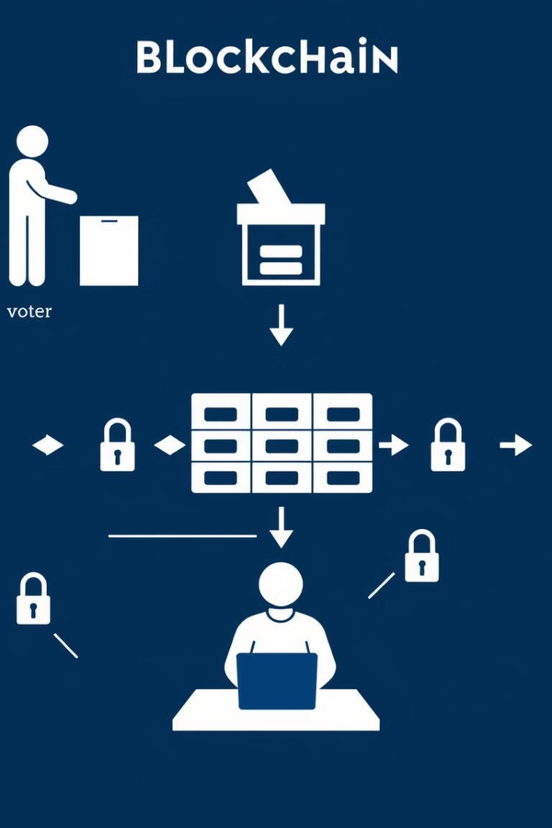



Technical Architecture
Blockchain
Permissioned for controlled access.
Smart Contracts
Automate the voting process.
Encryption
Protects voter anonymity.

Slide 6
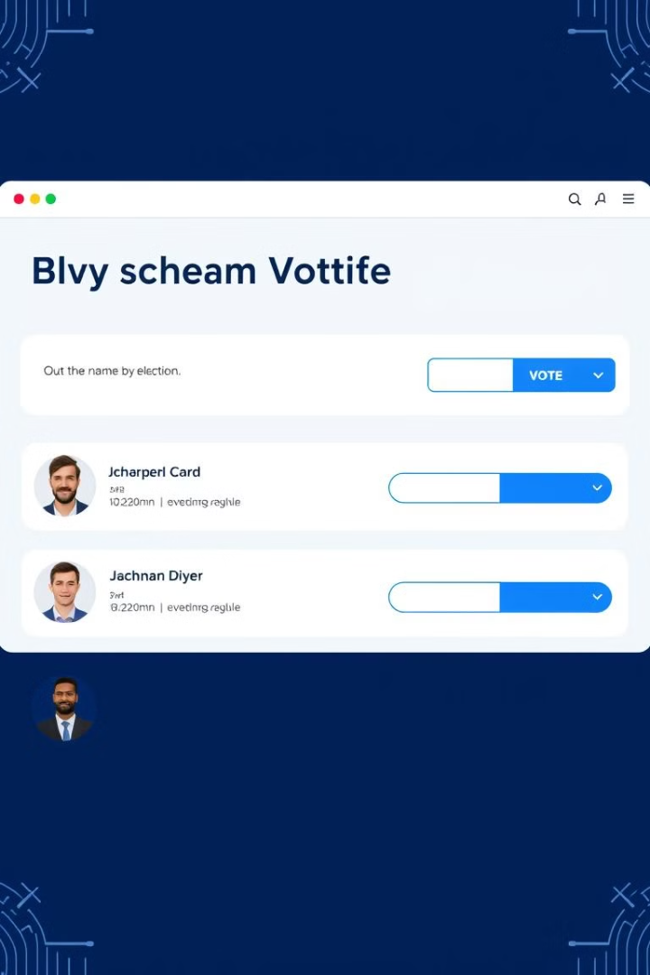
Prototype: User Interface
Secure Login
Candidate Info
Robust authentication for authorized access.
Detailed profiles for informed decisions.
Real-Time Audit
Verifiable tracking of the voting process.

Slide 7

Benefits of Blockchain Voting
Security
Cost Savings
Resistance to hacking.
Lower expenses compared to traditional elections.
1
2
3
Transparency
Publicly verifiable audit trail.

Slide 8
Challenges and Mitigation
Regulatory Hurdles
1
Comply with election laws.
Voter Education
2
Ensure system understanding.
Security Risks
3
Ongoing monitoring and audits.

Slide 9
Sample Code
import { SHA256 } from "crypto-js";
// Block Class - Represents each block in the blockchain
class Block {
constructor(timestamp, votes, previousHash = "") {
this.timestamp = timestamp;
this.votes = votes;
this.previousHash = previousHash;
this.hash = this.calculateHash();
this.nonce = 0;
}
calculateHash() {
return SHA256(
this.previousHash +
this.timestamp +
JSON.stringify(this.votes) +
this.nonce
).toString();
}
mineBlock(difficulty) {
while (
this.hash.substring(0, difficulty) !== Array(difficulty + 1).join("0")
) {
this.nonce++;
this.hash = this.calculateHash();
}
}
}
// Blockchain Class - Manages the entire chain
class Blockchain {
constructor() {
this.chain = [this.createGenesisBlock()];
this.difficulty = 2;
this.pendingVotes = [];
}
createGenesisBlock() {
return new Block(Date.now(), [], "0");
}
getLatestBlock() {
return this.chain[this.chain.length - 1];
}
addVote(voter, candidate) {
this.pendingVotes.push({
voter,
candidate,
timestamp: Date.now(),
});
}
minePendingVotes() {
const block = new Block(
Date.now(),
this.pendingVotes,
this.getLatestBlock().hash
);
block.mineBlock(this.difficulty);
this.chain.push(block);
this.pendingVotes = [];
}
isChainValid() {
for (let i = 1; i < this.chain.length; i++) {
const currentBlock = this.chain[i];
const previousBlock = this.chain[i - 1];
if (currentBlock.hash !== currentBlock.calculateHash()) {
return false;
}
if (currentBlock.previousHash !== previousBlock.hash) {
return false;
}
}
return true;
}
getVoteCount() {
const voteCount = {};
for (const block of this.chain) {
for (const vote of block.votes) {
voteCount[vote.candidate] = (voteCount[vote.candidate] || 0) + 1;
}
}
return voteCount;
}
hasVoted(voter) {
return this.chain.some(block =>
block.votes.some(vote => vote.voter === voter)
);
}
}
import React, { useState } from "react";
import { motion } from "framer-motion";
import { votingChain } from "./blockchain";
const VotingSystem = () => {
const [voter, setVoter] = useState("");
const [candidate, setCandidate] = useState("");
const [results, setResults] = useState({});
const handleVote = () => {
if (!voter || !candidate) {
alert("Please fill in all fields");
return;
}
if (votingChain.hasVoted(voter)) {
alert("You have already voted");
return;
}
try {
votingChain.addVote(voter, candidate);
votingChain.minePendingVotes();
alert("Vote recorded successfully!");
setVoter("");
setCandidate("");
updateResults();
} catch (error) {
alert("Failed to record vote");
}
};
const updateResults = () => {
setResults(votingChain.getVoteCount());
};
return (
<div className="min-h-screen bg-gradient-to-b from-gray-900 to-gray-800 text-white p-8">
<div className="max-w-2xl mx-auto">
<motion.div
initial={{ opacity: 0, y: 20 }}
animate={{ opacity: 1, y: 0 }}
className="bg-gray-800 rounded-lg p-8 shadow-xl"
>
<h1 className="text-3xl font-bold mb-8 text-center">
Blockchain Voting System
</h1>
{/* Voting Form */}
<div className="space-y-6">
<div>
<label className="block text-sm font-medium mb-2">
Voter ID
</label>
<input
type="text"
value={voter}
onChange={(e) => setVoter(e.target.value)}
className="w-full px-4 py-2 rounded bg-gray-700"
placeholder="Enter your voter ID"
/>
</div>
<div>
<label className="block text-sm font-medium mb-2">
Candidate
</label>
<input
type="text"
value={candidate}
onChange={(e) => setCandidate(e.target.value)}
className="w-full px-4 py-2 rounded bg-gray-700"
placeholder="Enter candidate name"
/>
</div>
<button
onClick={handleVote}
className="w-full bg-blue-600 hover:bg-blue-700 py-2 rounded"
>
Cast Vote
</button>
</div>
{/* Results Display */}
<div className="mt-8">
<h2 className="text-xl font-semibold mb-4">Results</h2>
<div className="space-y-2">
{Object.entries(results).map(([candidate, votes]) => (
<div
key={candidate}
className="flex justify-between items-center bg-gray-700 p-3 rounded"
>
<span>{candidate}</span>
<span className="font-bold">{votes} votes</span>
</div>
))}
</div>
</div>
</motion.div>
</div>
</div>
);
};
export default VotingSystem;

Slide 10

Conclusion: The Future is Now
Blockchain voting offers a secure, transparent, and efficient solution. Secure funding for a pilot program and continue development and testing. Join us in revolutionizing democracy!

